Slide 1







Robust M-Estimation Based SVM
for Improving Binary Classification
이중 분류 성능 향상을 위한 강건한 M-추정 기반 SVM
김민경, 유지아, 윤진희
Min Kyung Kim, Jia You, Jin Hee Yoon
Sejong Univ., South Korea

Slide 2

1. Introduction
• Support Vector machines(SVMs) are widely used for binary classification.
• Key strengths:
- Strong generalization, even with small datasets
- Flexible via kernel functions
- Guarantees global optimum (quadratic programming)
03

Slide 3
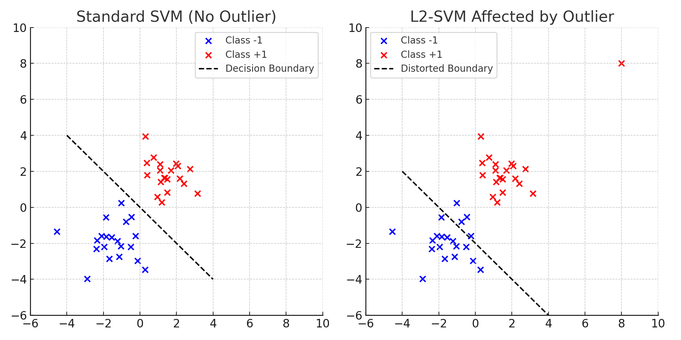
1. Introduction
• L1-SVM : minimizes linear sum of slack variables.
• L2-SVM : minimizes squared sum of slack variables $→$ sensitive to outliers
03

Slide 4
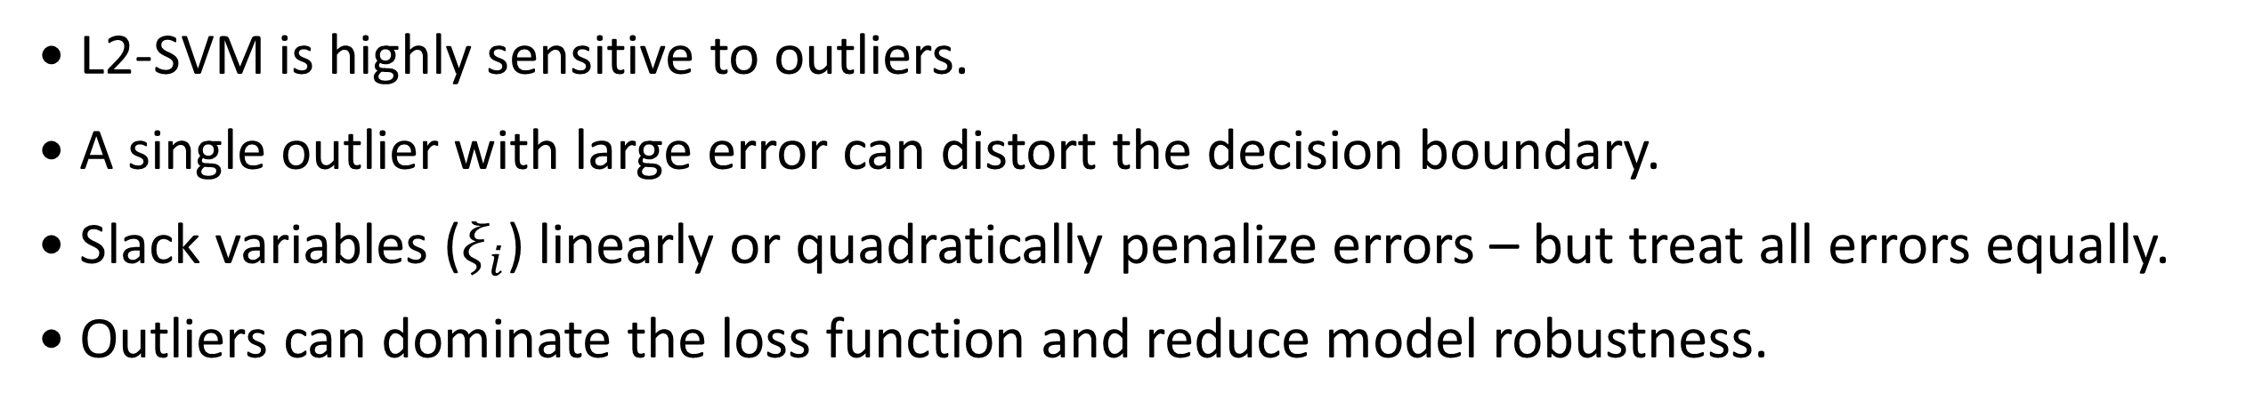
2. Limitations of Traditional SVMs
Sensitivity to Outliers
• L2-SVM is highly sensitive to outliers.
• A single outlier with large error can distort the decision boundary.
• Slack variables ($ξ_{i}$) linearly or quadratically penalize errors – but treat all errors equally.
• Outliers can dominate the loss function and reduce model robustness.
05

Slide 5
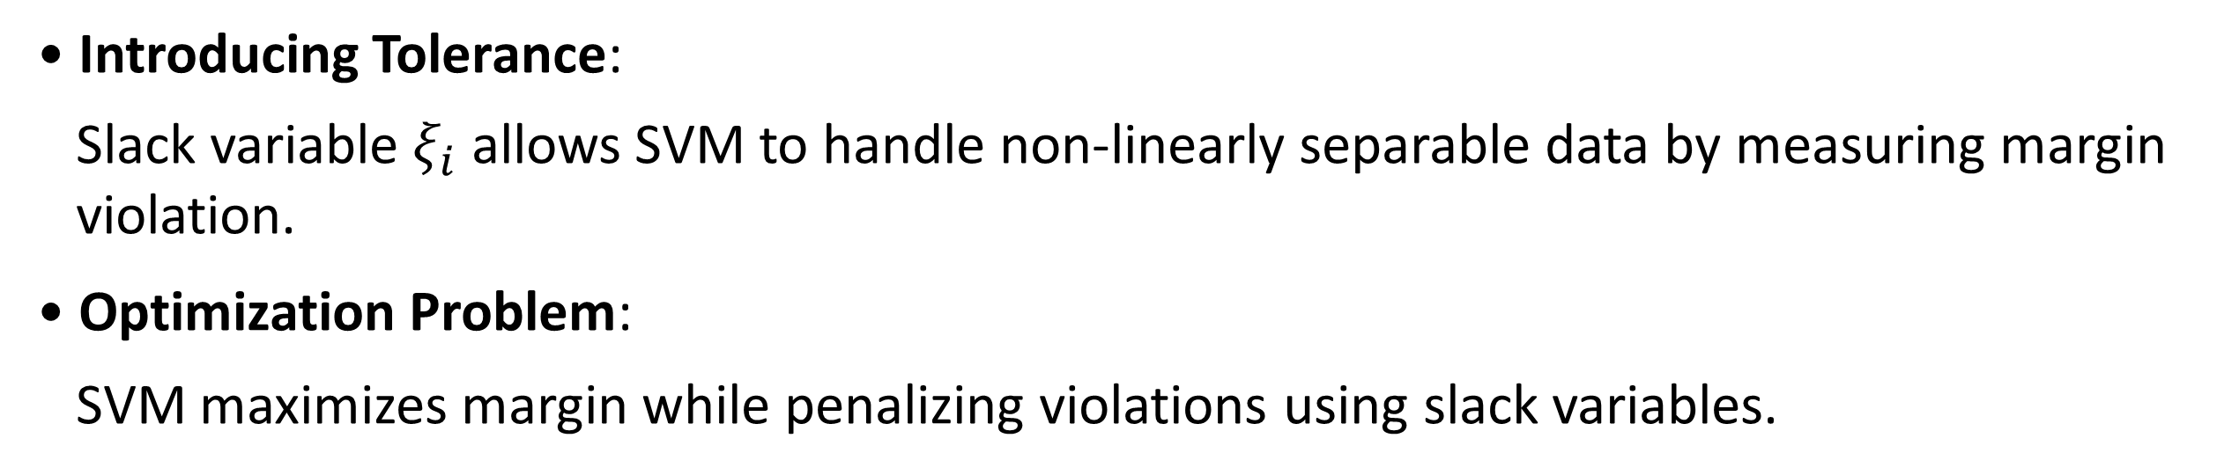
2. Limitations of Traditional SVMs
Role of Slack Variables $ξ_{i}$
• Introducing Tolerance:
Slack variable $ξ_{i}$ allows SVM to handle non-linearly separable data by measuring margin
violation.
• Optimization Problem:
SVM maximizes margin while penalizing violations using slack variables.
06

Slide 6
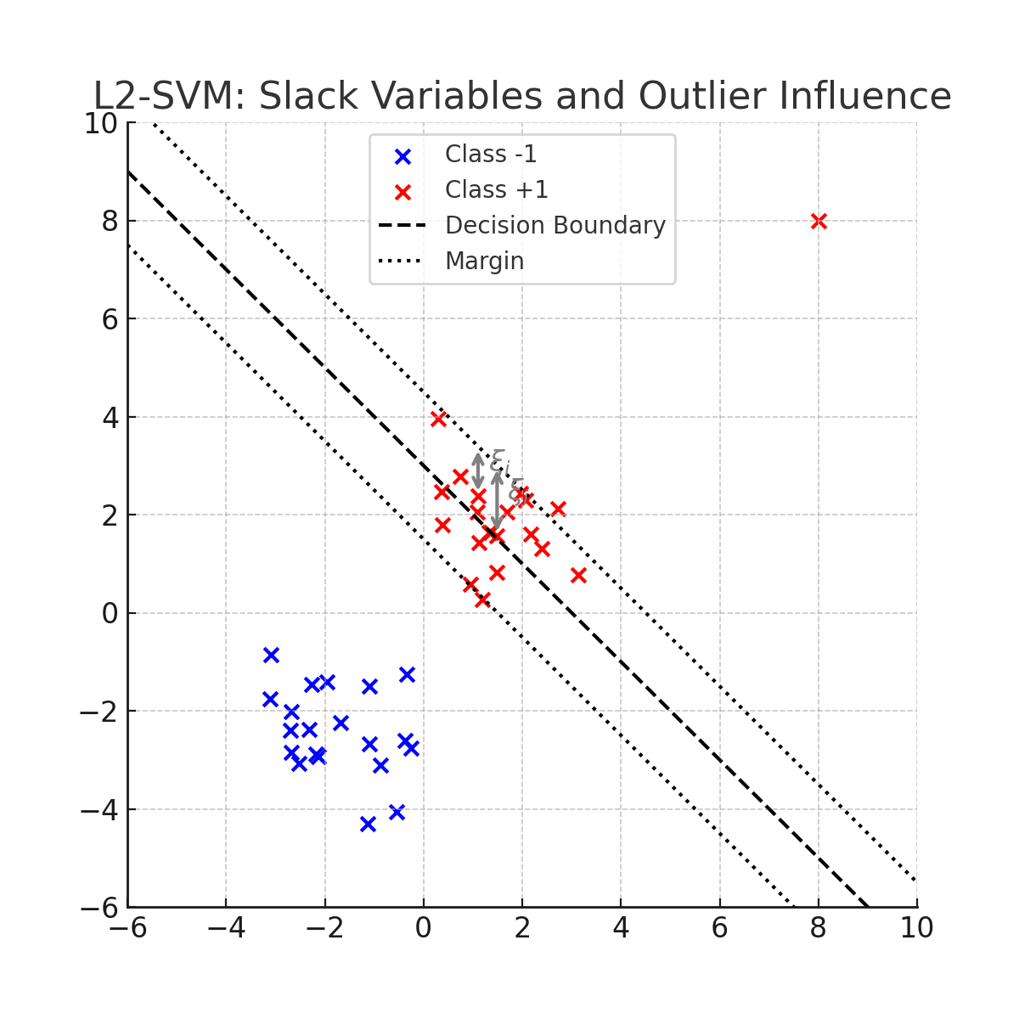
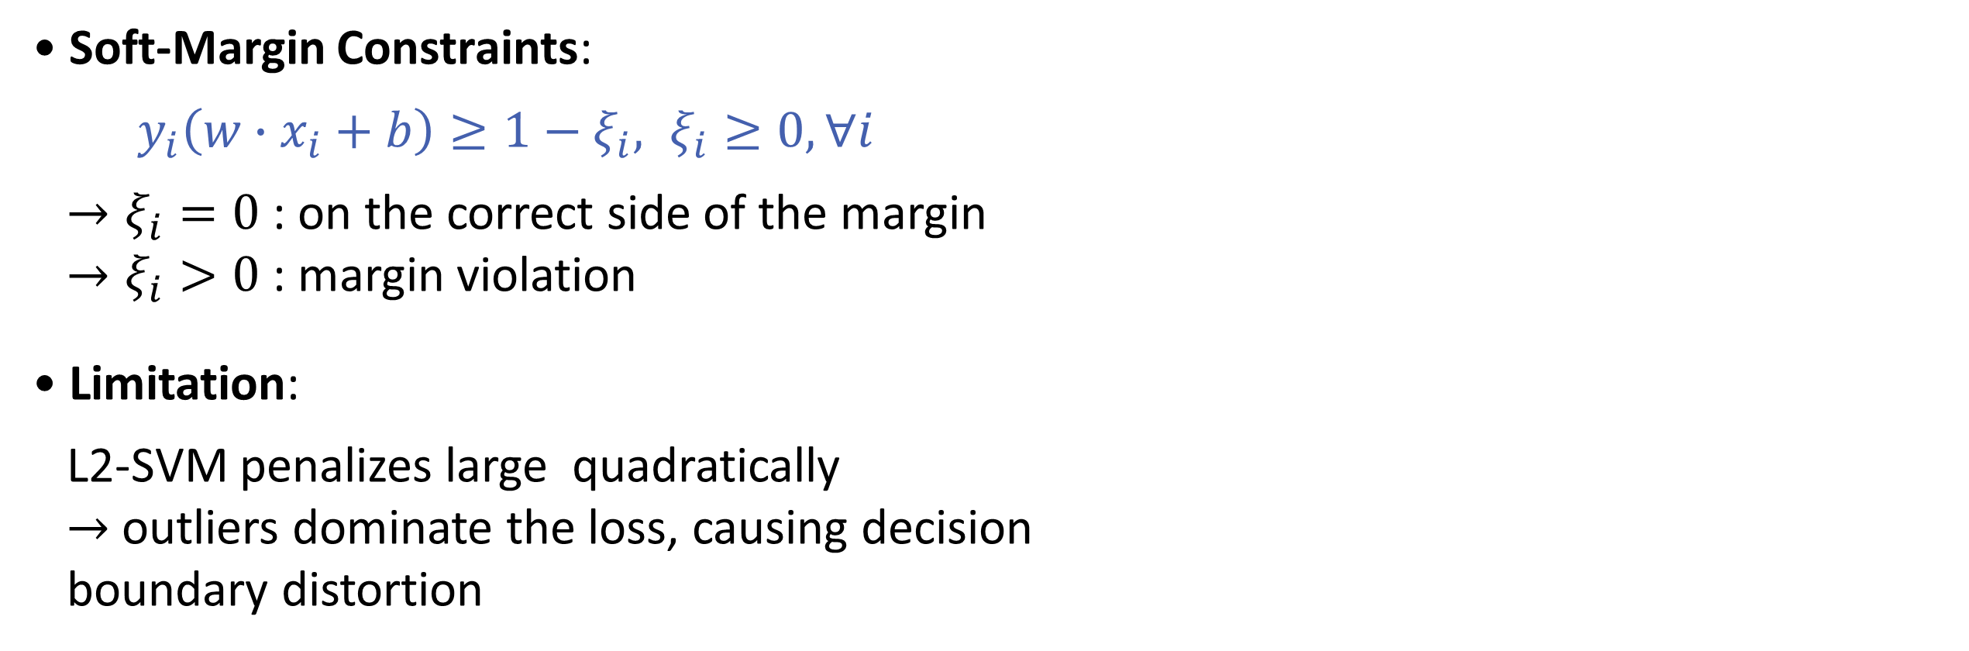
2. Limitations of Traditional SVMs
Role of Slack Variables $ξ_{i}$
• Soft-Margin Constraints:
$y_{i}\left(w∙x_{i}+b\right)≥1−ξ_{i}, ξ_{i}≥0, ∀i$
$→ξ_{i}=0$ : on the correct side of the margin
$→ξ_{i}>0$ : margin violation
• Limitation:
L2-SVM penalizes large quadratically
$→$ outliers dominate the loss, causing decision
boundary distortion
07

Slide 7
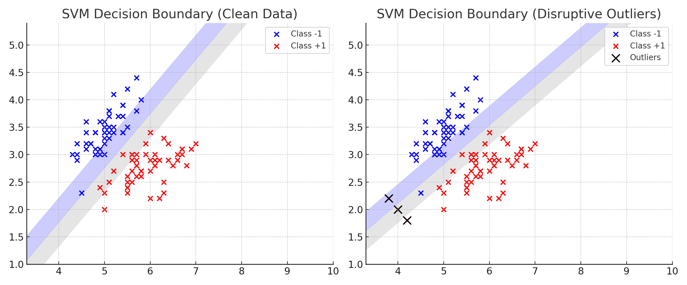
3. Motivation for Robust Methods
08

Slide 8
3. Motivation for Robust Methods
• Traditional SVMs assume that all training data are equally reliable.
• In practice, real-world data often contain noisy labels, measurement error, or outliers.
• L2-SVM heavily penalizes large deviations, causing outliers to dominate the model.
• Robust methods are needed to reduce the influence of extreme errors and learn a more
stable decision boundary.
• M-Estimators offer a flexible way to down-weight the impact of outliers by using
non-quadratic loss functions.
09

Slide 9
3. Limitations of L1-SVMs and L2-SVMs
The Importance for Robustness in SVM
• To address this limitation, our study proposes a framework that integrates M-estimation-
based loss functions.
10

Slide 10
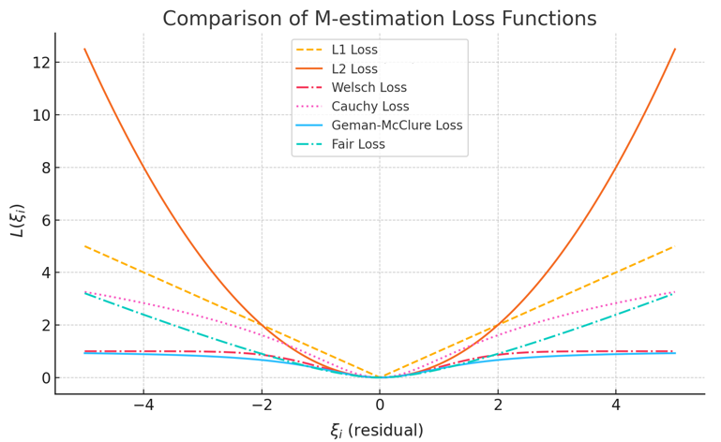
3. Limitations of L1-SVMs and L2-SVMs
The Importance for Robustness in SVM
• Unlike L1 and L2 loss, M-estimation loss suppress the impact of large errors, making the
model more robust to outliers.
11

Slide 11
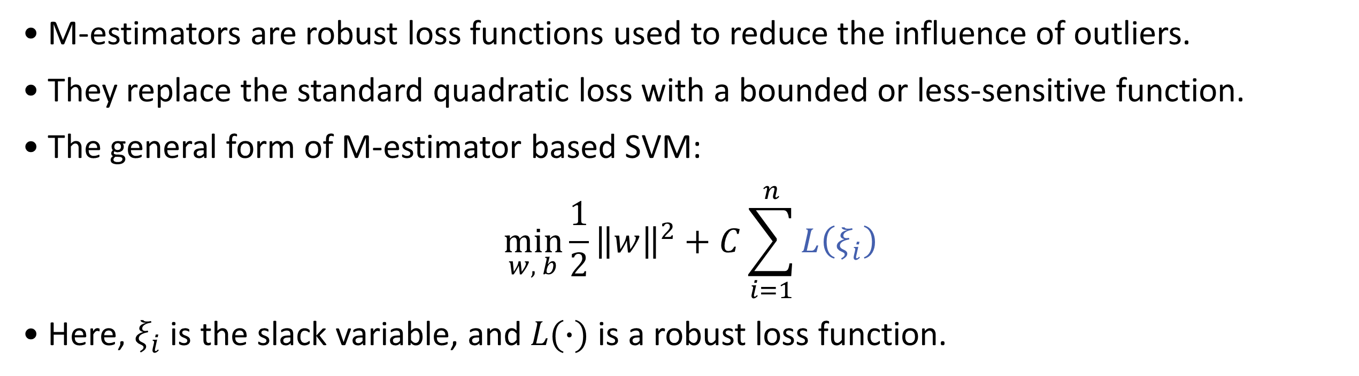
4. M-Estimator-based SVM
• M-estimators are robust loss functions used to reduce the influence of outliers.
• They replace the standard quadratic loss with a bounded or less-sensitive function.
• The general form of M-estimator based SVM:
$$\min_{w, b}\frac{1}{2}{\left\|w\right\|}^{2}+C\sum_{i=1}^{n}{L\left(ξ_{i}\right)}$$
• Here, $ξ_{i}$ is the slack variable, and $L(∙)$ is a robust loss function.
12

Slide 12
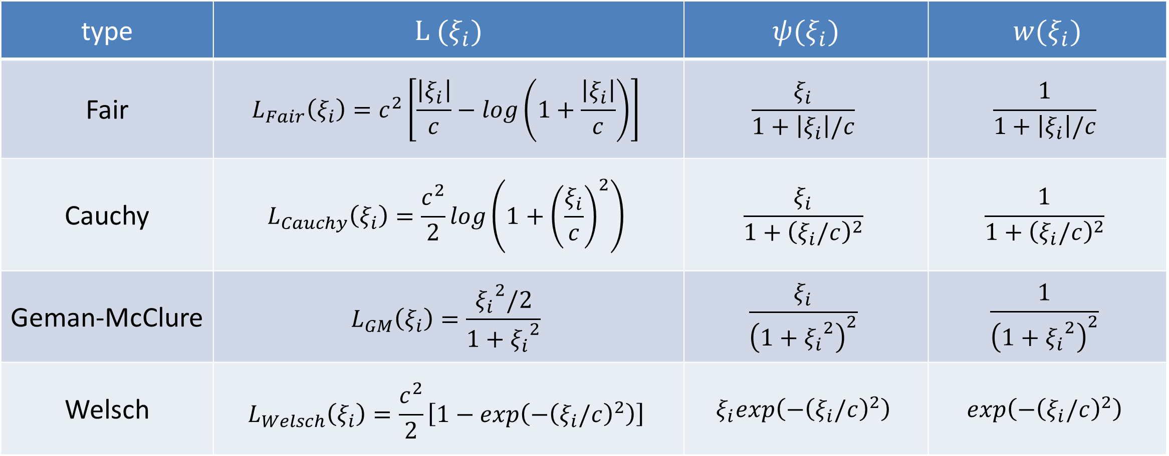
4. M-Estimator-based SVM
Some examples of common functions used in M-Estimators
type | $$L (ξ_{i})$$ | $$ψ(ξ_{i})$$ | $$w(ξ_{i})$$
Fair | $$L_{Fair}\left(ξ_{i}\right)=c^{2}\left[\frac{\left|ξ_{i}\right|}{c}−log\left(1+\frac{\left|ξ_{i}\right|}{c}\right)\right]$$ | $$\frac{ξ_{i}}{1+\left|ξ_{i}\right|/c}$$ | $$\frac{1}{1+\left|ξ_{i}\right|/c}$$
Cauchy | $$L_{Cauchy}\left(ξ_{i}\right)=\frac{c^{2}}{2}log⁡\left(1+{\left(\frac{ξ_{i}}{c}\right)}^{2}\right)$$ | $$\frac{ξ_{i}}{1+{\left(ξ_{i}/c\right)}^{2}}$$ | $$\frac{1}{1+{\left(ξ_{i}/c\right)}^{2}}$$
Geman-McClure | $$L_{GM}\left(ξ_{i}\right)=\frac{{ξ_{i}}^{2}/2}{1+{ξ_{i}}^{2}}$$ | $$\frac{ξ_{i}}{{\left(1+{ξ_{i}}^{2}\right)}^{2}}$$ | $$\frac{1}{{\left(1+{ξ_{i}}^{2}\right)}^{2}}$$
Welsch | $$L_{Welsch}\left(ξ_{i}\right)=\frac{c^{2}}{2}\left[1−exp\left(−{\left(ξ_{i}/c\right)}^{2}\right)\right]$$ | $$ξ_{i}exp\left(−{\left(ξ_{i}/c\right)}^{2}\right)$$ | $$exp\left(−{\left(ξ_{i}/c\right)}^{2}\right)$$
13

Slide 13
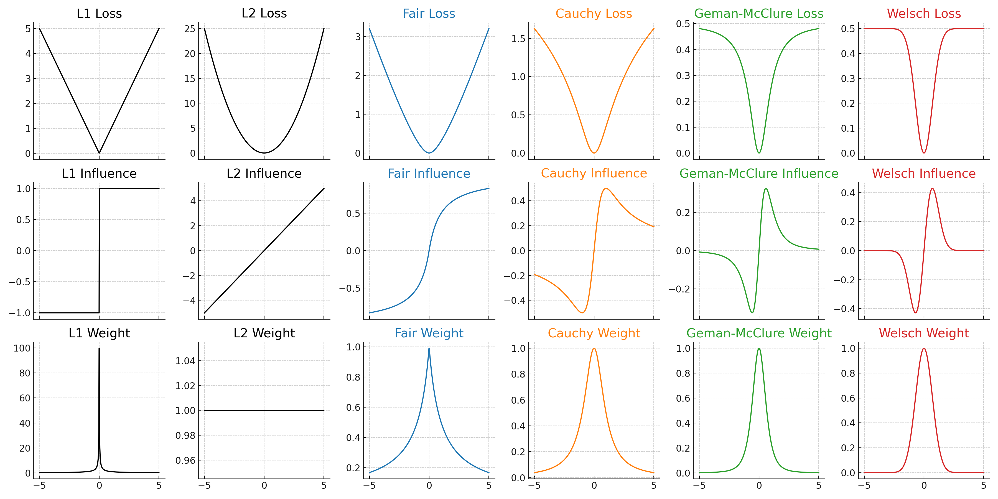
4. M-Estimator-based SVM
14

Slide 14
4. M-Estimator-based SVM
4-1. Type Fair-SVMs
• Loss: Smoothly increases and grows slower than L2 loss.
• Influence: Nearly linear for small residuals,
but gradually saturates as the residual increases.
• Weight: Decreases slowly with large residuals.
• Interpretation: Effectively limits the influence of large errors
while preserving sensitivity to small ones.
16

Slide 15
4. M-Estimator-based SVM
4-2. Type Cauchy-SVMs
• Loss: Logarithmic growth – very slow increase for large errors.
• Influence: Rapidly decreases to zero as residual grows.
• Weight: Drops quickly for large errors.
• Interpretation: Strongly suppresses extreme outliers, making
the model very robust.
17

Slide 16
4. M-Estimator-based SVM
4-3. Type Geman-McClure
• Loss: Quadratic for small errors, bounded for large ones.
• Influence: Strong at small residuals but rapidly diminishes as
residual increases.
• Weight: Drops steeply with increasing residual size.
• Interpretation: Structurally suppresses large residuals to
prevent outlier influence.
18

Slide 17
4. M-Estimator-based SVM
4-4. Type Welsch
• Loss: Bounded and smooth, flattens out for large residuals.
• Influence: Only responsive to moderate errors; negligible
effect for both very small and very large errors.
• Weight: Highest near zero, quickly vanishes away from the
center.
• Interpretation: Focuses on medium-level noise, while ignoring
outliers and tiny fluctuations.
19

Slide 18
5. Data Analysis
• Objective
Evaluate the robustness and performance of M-estimator-based SVMs under noisy and
outlier-contaminated data conditions.
Compare optimization algorithms (SMO, GA, PSO, ACO, HS) in terms of classification
performance and efficiency.
• Datasets
We used four publicly binary classification datasets:
Arrhythmia, Madelon, WBC (Wisconsin Breast Cancer), Ionosphere
To simulate real-world scenarios, we added synthetic noise and outliers into each dataset.
20

Slide 19
5. Data Analysis
• Synthetic Data & Outlier Injection
A synthetic binary classification dataset was generated:
200 samples, 2 informative features
Class labels were encoded as +1 / -1 for SVM compatibility.
We created two versions of the dataset:
- “One with 1% outliers (baseline)”
- “One with 5% outliers (higher noise level)”
21

Slide 20
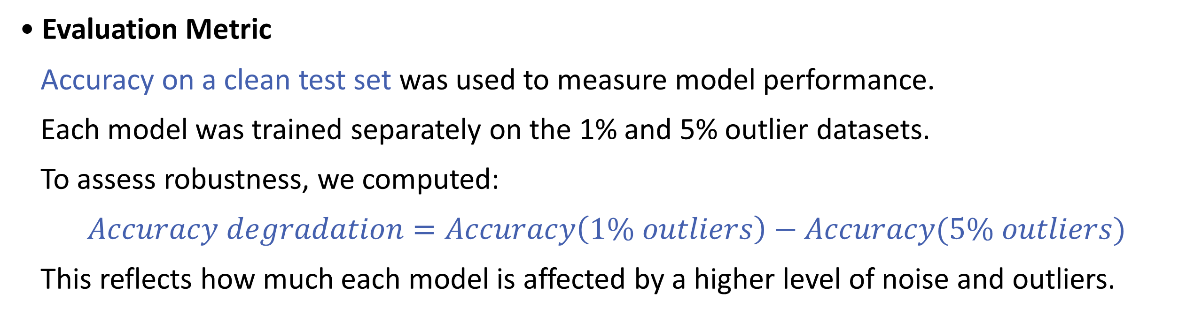
5. Data Analysis
• Evaluation Metric
Accuracy on a clean test set was used to measure model performance.
Each model was trained separately on the 1% and 5% outlier datasets.
To assess robustness, we computed:
$$Accuracy degradation=Accuracy\left(1\% outliers\right)−Accuracy(5\% outliers)$$
This reflects how much each model is affected by a higher level of noise and outliers.
22

Slide 21
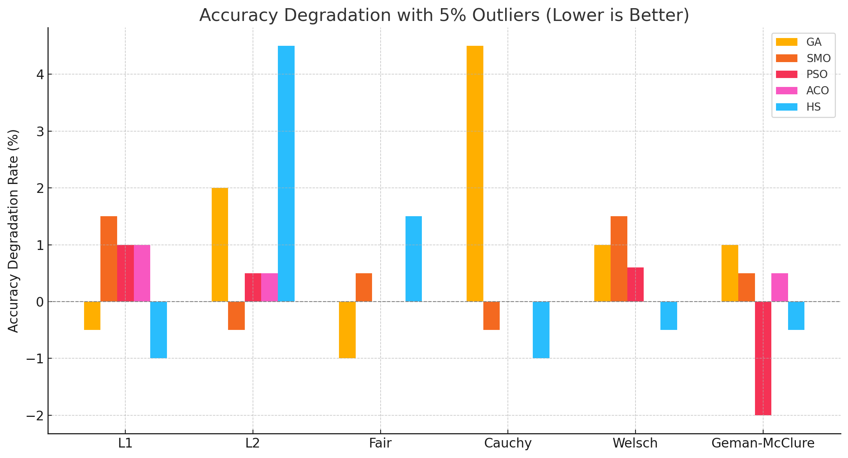
• This chart shows the change in accuracy after adding 5% outliers to the training data.
Some models, like ‘PSO+GM’ or ‘HS+Cauchy’, even showed slight accuracy gains, indicating
strong robustness against noise and outliers.
On the other hand, combinations such as ‘GA+Cauchy’ suffered significant accuracy drops,
suggesting higher sensitivity to outlier contamination.
23

Slide 22
5. Data Analysis
• In a few cases, the model’s accuracy improved after injecting outliers.
While this might seem like a positive effect, it’s likely due to favorable shifts in the data
distribution.
Therefore, we interpret such improvements cautiously and focus more on minimizing
performance degradation across conditions.
24

Slide 23
5. Data Analysis
Experimental Setting
• 4 binary classification datasets: Arrythmia, Madelon, WBC, Ionosphere
• Each dataset originally contains a small percentage of outliers
• We increased the outlier ratio to 10% by injecting synthetic outliers
• Models: SVMs using M-estimation loss functions
(Fair, Cauchy, Welsch, Geman-McClure) and traditional (L1, L2)
• Optimization methods: GA, SMO, PSO, ACO, HS
• Metric: Accuracy difference from original outlier ratio to 10%
(Lower values -> More robust to outliers)
25

Slide 24
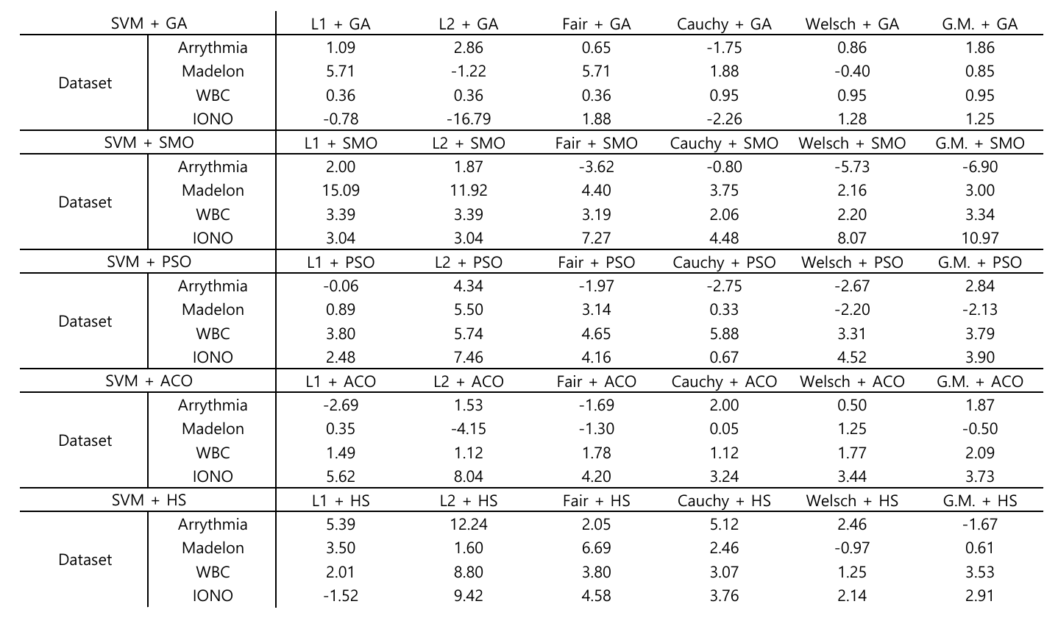
5. Data Analysis
26

Slide 25
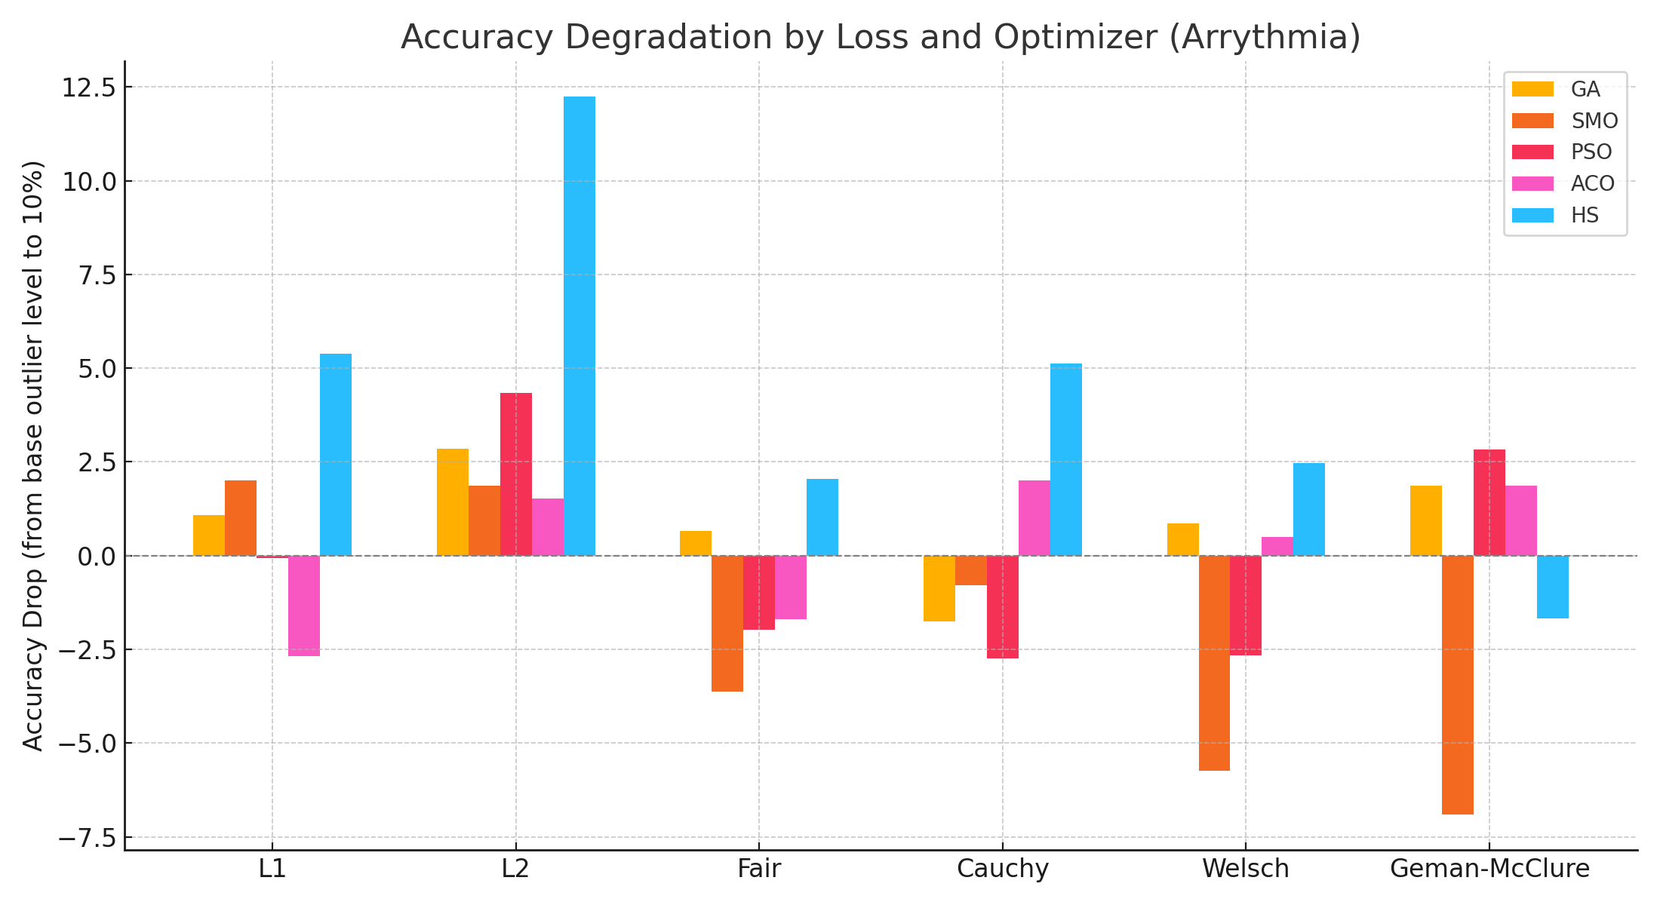
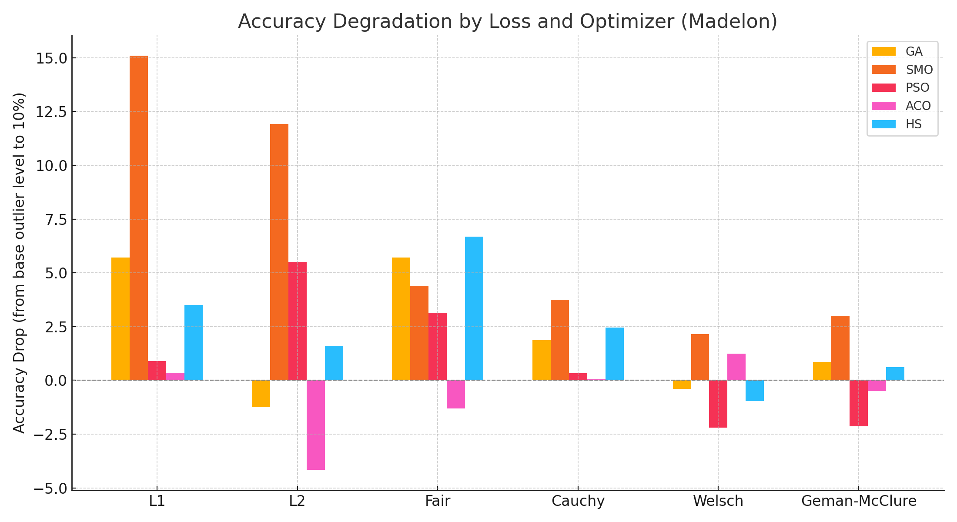
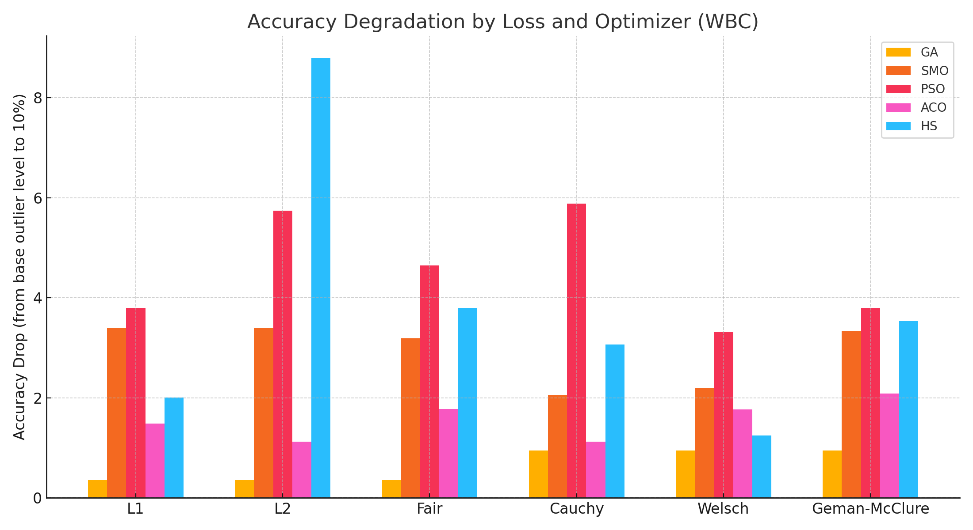
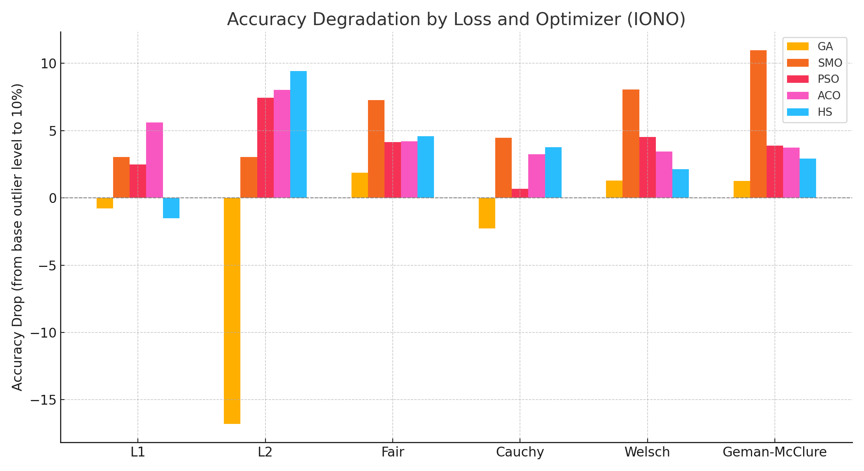
5. Data Analysis
27

Slide 26
5. Data Analysis
• Some combinations showed a negative degradation rate, meaning that their accuracy
improved after adding more outliers.
While interesting, these cases may be due to noise patterns or random variations.
So for robust conclusion, we focus only on models with the smallest positive degradation,
indicating consistent performance under increasing outlier conditions.
28

Slide 27
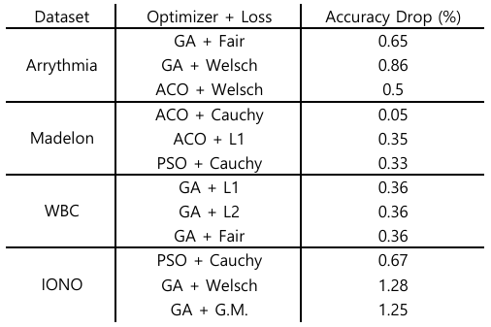
5. Data Analysis
• After excluding the combinations where accuracy improved unexpectedly, we identified
the most robust models by their lowest positive degradation.
These results represent the combinations that consistently maintained performance as
outlier ratios increased to 10%.
29

Slide 28
6. Conclusion
• Support vector Machines are widely used, but they are known to be sensitive to outliers.
Our goal was to enhance SVM’s robustness using M-estimation-based loss functions.
• We experimented with 6 different loss functions and 5 optimization algorithms across
4 datasets, evaluating how each model responded to increased outlier levels.
30

Slide 29
6. Conclusion
• The results show that M-estimation-based loss functions – particularly Cauchy and Welsch
– combined with optimizers like ACO or PSO, offer superior robustness against outliers.
For example, PSO + Cauchy on Ionosphere and ACO + Cauchy on Madelon showed minimal
accuracy drop even with 10% outliers.
• This suggests that SVMs can be made significantly more robust by choosing the right
combination of loss and optimization strategy.
In future work, we aim to extent this to multi-class problems and apply it to real-work
datasets such as biomedical or financial data.
31

Slide 30




